Slide 1
Capstone Project: The Battle of Neighbourhoods
IBM Data Science Professional Certificate
SOBHAN AHMADI
MAY 2020

Slide 2
Background
Toronto, with 2,731,571 population in 2016, is the capital of Ontario Province, the most populous city in Canada, and the fourth largest populous city in North America.
Toronto contains a geographical area previously administered by different municipalities.
These municipalities have each created a unique history and identity over the years.

Slide 3
Problem Definition and Interest
In this project, we want to explore the neighborhoods in Toronto and group them into similar and dissimilar clusters.
This study can be interesting for those who want to live temporary or for a long period in Toronto including new residents, tourists, and people who want to change their neighborhood.
This project will help them to know every area in Toronto and choose their new and favorite neighborhood.

Slide 4
Data Sources
Information about neighborhoods in Toronto: https://en.wikipedia.org/wiki/List_of_postal_codes_of_Canada:_M
The geographical coordinates of different neighborhoods: http://cocl.us/Geospatial_data
Finally, we request the venue data for each neighborhood from the Foursquare API.

Slide 5
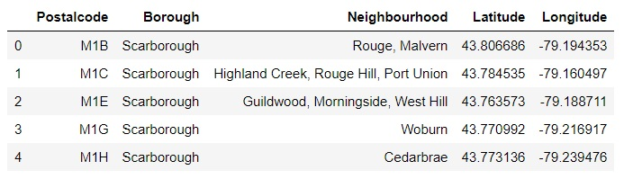
Feature Selection
After all the merging and cleaning data, we consider the following table (there are 103 rows and five columns).

Slide 6
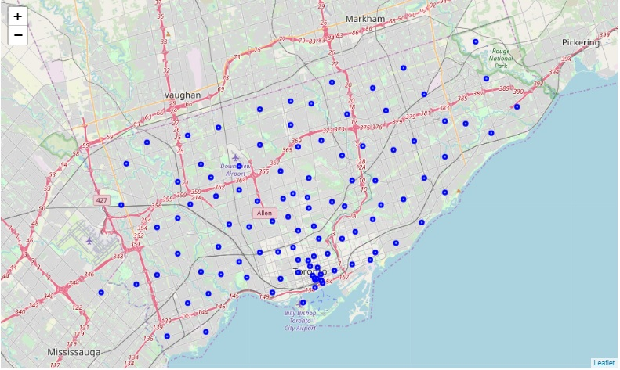
Toronto Neighborhoods on the Map

Slide 7
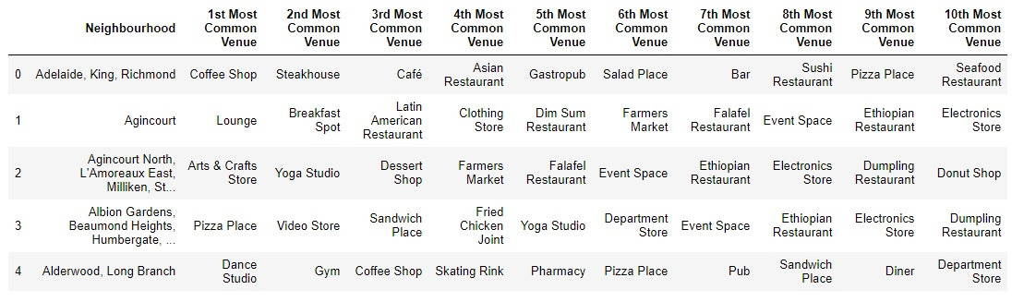
Using Foursquare API to Explore each Neighborhood

Slide 8
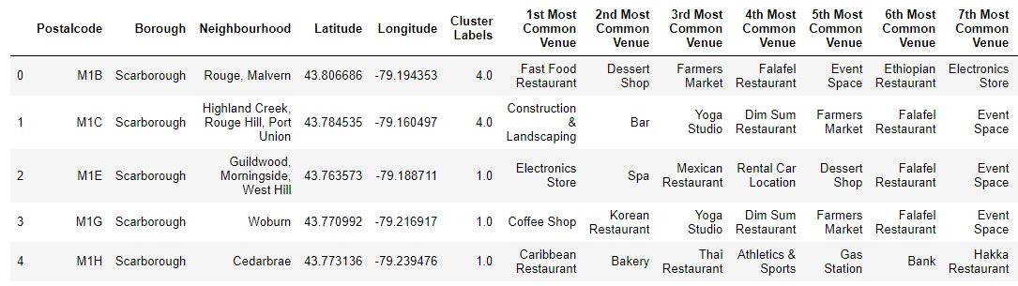
Results
We categorize the neighborhoods into 6 clusters (by using K-means algorithm) as follows.

Slide 9
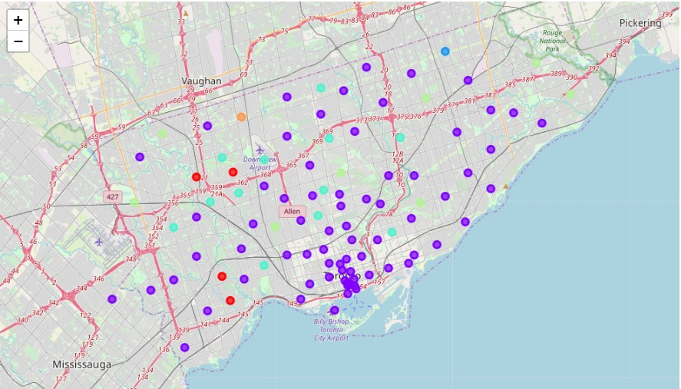
Results
The following map visualizes the cluster of each neighborhood in Toronto by using the Folium package and Matplotlib library.

Slide 10
Conclusion and Future Directions
Developing recommendations to the people who want to live temporary or for a long period in Toronto including new residents, tourists, and people who want to change their neighborhood to choose their new area.
Considering other algorithms to cluster neighborhoods and compare the results of different algorithms.
Finding a way to determine the optimal number of clusters (k) before performing the K-means algorithm.

Slide 11
Thank you!

